Slide 1
Women in The Odyssey
Was Homer a woman?

Slide 2
Authoress Theories:
Samuel Butler, The Authoress of the Odyssey (1897)
  Homer was Nausicaa, princess of Trapani
Andrew Dalby, Rediscovering Homer (2006)
  “Since we begin with no facts at all about the poet who saw the Iliad and the Odyssey written down, no one can deny that she might have been a woman” (141)

Slide 3
Women and goddesses
Athene
Penelope
Helen
Circe
Nausicaa
Eurycleia (the “nurse”)
  All very clearly defined characters
  Most play a pivotal role in the plot
  Exercise: can you say what that role is?

Slide 4
Why are these women so clearly characterized?
Penelope: 1.328-344
Helen: 4.130-148; 219-305
Nausicaa
  6.186-210 (but given a longer introduction)
  8.457-469
Circe: 10.308-348
  Look at these passages
  What details are particularly vivid?

Slide 5
Penelope: 1.328-344
Slave girls
Veil
Weeping
Links the famous public story to the individual and their emotions

Slide 6
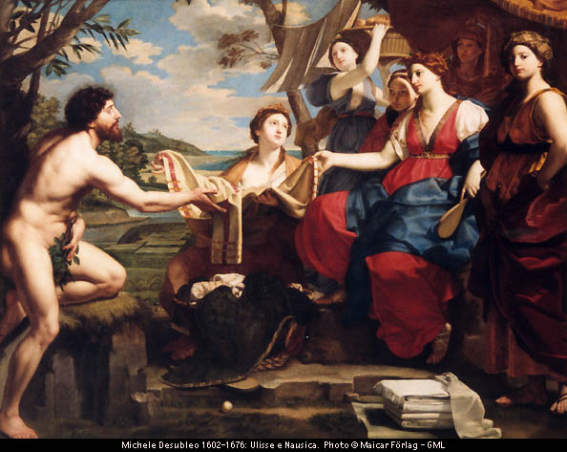

Slide 7
Woman and patriarchal order
Greek society patriarchal: strong emphasis on male lineage and values
Representations of women: focus on “otherness”
Do they appear at moments of peril for male characters?
Add excitement to the story?
Or reinforce male supremacy?

Slide 8
Women as disturbance
Circe: threatens Odysseus sexual potency
Calypso: obstacle to Odysseus’ return
Nausicaa: potential distraction: 7.297-319
  Compare Dido in The Aeneid
Penelope: postpones recognition
Odysseus’ response to them?

Slide 9
Odysseus’ story of Agamemnon
Read 11.397-462
Who is telling this story?
  To whom?
  What picture of men emerges from this story?
  What picture of women?

Slide 10
Women move the plot
Arete: the route home
  7.66-78; 11.336-62
23.178-210 Penelope tests Odysseus
  Reveals herself as the centre of the plot
  Cf. 23.111-2
    “You must allow your mother to test me out…”

Slide 11
Women focalizing emotions
Penelope and the bard: 1.336-59
8.521-35: Odysseus weeps like a woman
  cf. 8.84-97

Slide 12
Dead Women
Odysseus’ mother Anticleia
  First of the dead to speak after Tiresias
  Reveals that Penelope is still alone
  Produces an influential high-point of pathos:
  Then in my heart I wanted to embrace
  The spirit of my mother. She was dead,
  and I did no know how. Three times I tried,
  longing to touch her. But three times her ghost
  flew from my arms, like shadows or like dreams.
  Sharp pain pierced deeper in me as I cried…..
  11. 204-209
The procession of heroines
All of this persuades the Phaeacian court

Slide 13
So is it a poem about women?
Penelope’s fidelity
Athena’s interventions
Female monsters
Odysseus’ virility
The Trojan war
The maids in Ithaca (more next time)

Slide 14
Odyssey explores gender relationships
Boundaries between worlds of men and worlds of women
An expansion outside the narrow range of The Iliad
Sex and power always closely connected

